Slide 1
Understanding Quenching & Efficiency Roll-off
Kyle Hershey
9/22/14

Slide 2
Motivation
Understand exciton and carrier dynamics within OLED devices
Unified Model
Steady state roll-off
Roll-off – Reduction in efficiency with increasing current density
Model has been developed, but cannot fit transient behavior
Erickson and Holmes, Adv. Func. Mat. 2014
Transient electroluminescence
Typically fit with bi-exponential decay
No physical meaning
Closest model for EL relies on broader exciton dynamics
Does not discuss carrier dynamics
Y. Zhang and S.R. Forrest, Phys. Rev. Lett. 108, 267404 (2012).
Can we use this unified model to say something about recombination zone effects?

Slide 3
Transient Electroluminescence
Pathway to luminescence:
Charge (polarons) injected via current
Polarons of opposite charge combine to for exciton
Exciton recombines, emitting light
Light intensity is proportional to exciton population
Exciton – Bound Electron-Hole Pair
Polaron – Electron or Hole with induced field in dielectric
or
Cathode
3.
ETL
1.
2.
EML
HTL
Anode
Two Populations of Interest:
Excitons: Directly correlate to Pulse Amplitude
Polarons: Form and Quench excitons

Slide 4
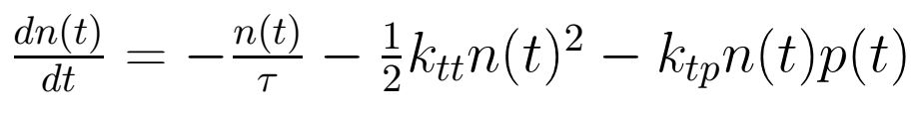

Model Development – v0. Steady State model
Model originated from steady state efficiency model
Assumed constant polaron population
$$τ$$
k_{tt}
k_{tp}

Slide 5
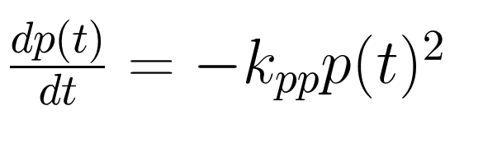
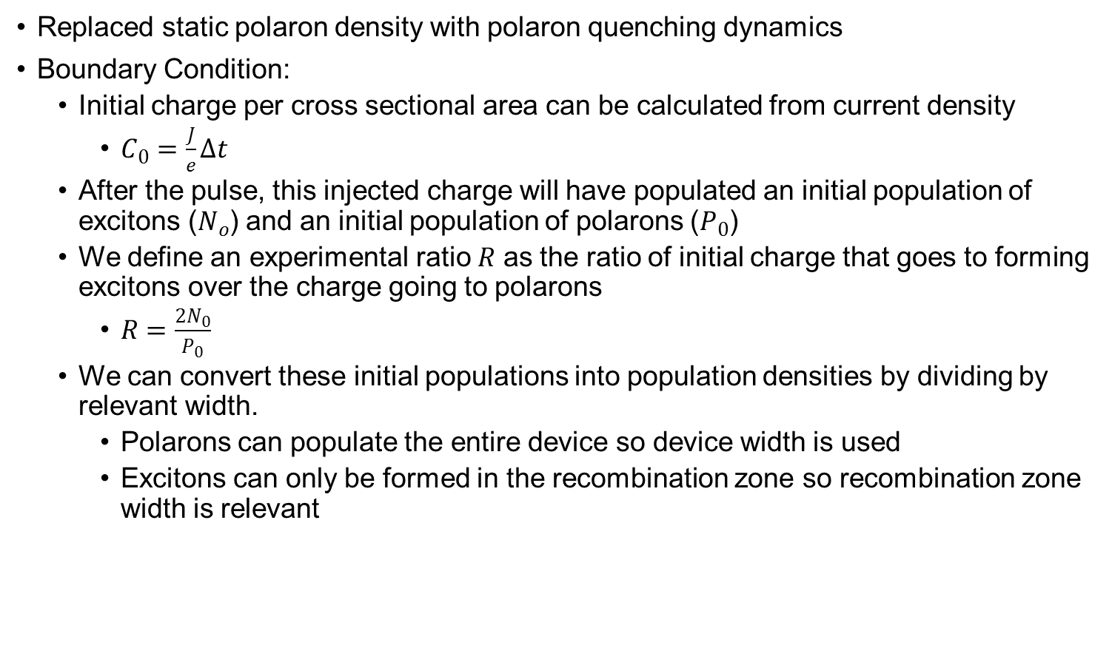
Model Development – v1. Polaron Dynamics
Replaced static polaron density with polaron quenching dynamics
Boundary Condition:
Initial charge per cross sectional area can be calculated from current density
$C_{0}=\frac{J}{e}∆t$
After the pulse, this injected charge will have populated an initial population of excitons ($N_{o}$) and an initial population of polarons ($P_{0}$)
We define an experimental ratio $R$ as the ratio of initial charge that goes to forming excitons over the charge going to polarons
$R=\frac{2N_{0}}{P_{0}}$
We can convert these initial populations into population densities by dividing by relevant width.
Polarons can populate the entire device so device width is used
Excitons can only be formed in the recombination zone so recombination zone width is relevant

Slide 6
Model Development – v1. Polaron Dynamics
Problems:
Not able to replicate curve behavior
Systematic undershoot of experimental data
Fit values highly dependent on
Ratio unexplained
k_{tt} | 2.62*10⁻¹² cm³/s
k_{tp} | 2.80*10⁻¹³ cm³/s
tau | 3.09*10⁻⁶ s
k_{pp} | 2.80*10⁻¹³ cm³/s
J | 17.57 A/cm²
ratio | 0.71001

Slide 7
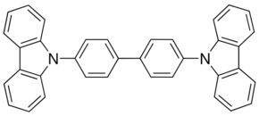
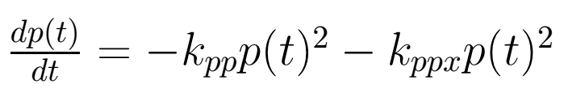
Model Development – v2. Polaron Crossing
Added Polaron crossing term (k_{ppx}) which allows polarons to combine to form an exciton
Simplified device architecture
Clearly defines recombination zone
Uniform excitons and polarons in EML
Uses previously described boundary condition at the end of the voltage pulse
2.4
2.6
30nm
TCTA
2.9
3
10nm
CBP:7%Irppy
30nm
Bphen
5.1
5.7
6
6.4
CBP

Slide 8
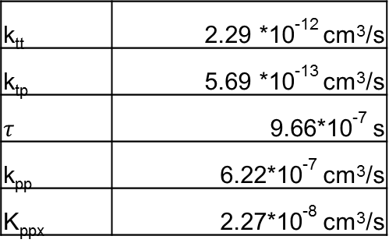
Model Development – v2. Polaron Crossing
First good fits
Ratio low value and trend with current density are unexplained
Tested to see if charge balance could explain trend
Charge balance is not the root cause
Is this a fitting artifact?
Can we avoid calculating ratio?
k_{tt} | 2.29 *10⁻¹² cm³/s
k_{tp} | 5.69 *10⁻¹³ cm³/s
$$τ$$ | 9.66*10⁻⁷ s
k_{pp} | 6.22*10⁻⁷ cm³/s
K_{ppx} | 2.27*10⁻⁸ cm³/s

Slide 9
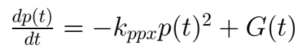
Model Development – v3. Full Transient
Fits full transient data
Starts when voltage pulse applied
No need for ratio since we are able to calculate populations explicitly
Initial charge carrier concentrations can be set to 0
k_{pp} removed
Fits seemed independent of parameter value
Generation term needed during pulse
Delay time after pulse start
Causes effective pulse to be shorter

Slide 10
Model Development – v3. Full Transient
Strong fits over current density, pulse width, and device area

Slide 11
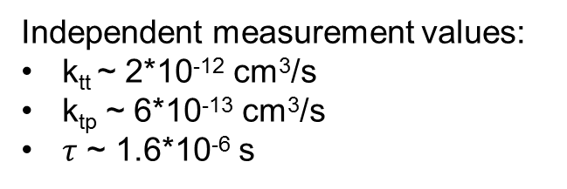
Model Development – v3. Full Transient
Independent measurement values:
k_{tt} ~ 2*10⁻¹² cm³/s
k_{tp} ~ 6*10⁻¹³ cm³/s
$τ$ ~ 1.6*10⁻⁶ s
Fit Parameters not shown:
J allowed to vary within 10%
Delay Time (next slide)
Effective pulse width

Slide 12
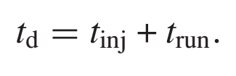
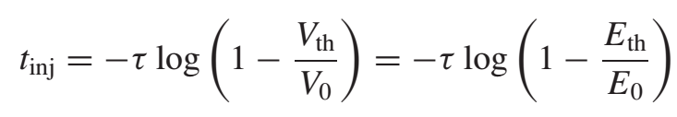
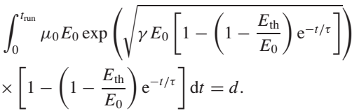
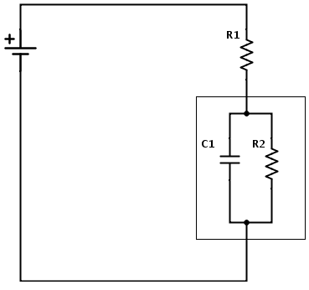
Origin of Transient Delay
Calculates delay from injection and transport
Injection based on equivalent circuit and turn on voltage
Transport from mobility
¹ B. Wei, K. Furukawa, J. Amagai, M. Ichikawa, T. Koyama, and Y. Taniguchi, Semicond. Sci. Technol. 19, L56 (2004).

Slide 13
Calculating the Ratio
250 ns pulse J~10 A/cm²
Charge injected = 8.24*10¹⁸cm⁻³
Given previous model (v2), what would R be to match new model exciton density
Calculated value corresponds to R=0.1
Agrees with previous fit R

Slide 14
Conclusions
Confident in fitting abilities over range of current density, pulse widths, device area
Agreement with independent measurements of parameters
All terms understood and explained

Slide 15
Future Work
Remaining Questions
What is the relevant width (recombination or device) for exciton and polaron densities?
Calculating charge density profile in injection layers to try to answer this question
Fitting is possible either way
Different Devices and architectures
k_{pp} may be needed for leakage in other devices
Gradients
Different Emitters
Fit steady state roll-off

Slide 16
Outcoupling Model
Kyle Hershey
9/22/14

Slide 17
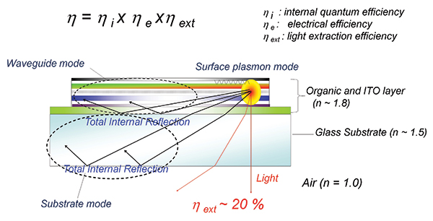
Out-coupling
Out-coupling is the percent of light generated that makes its way out of the device
Losses to waveguided modes, substrate, surface plasmons, absorption
Interest in wide recombination zone device optics
M-EML and G-EML devices
High efficiency results achievable
Previous studies have only looked at single emitter locations
Works well for SEML devices
Ignores broad emissive zone in MEML and GEML devices
http://informationdisplay.org/IDArchive/2013/SeptemberOctober/FrontlineTechnologyHighPerformance.aspx

Slide 18
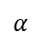
Power Dissipation Spectra Model
Radiated Power Density as a function of emitting dipole orientation
Uses reflection and transmission calculated using complex indices of refraction
Based on transfer matrix model
Orientation described as normalized in-plane wavevector (u)
Think of this as angle
Original model modified to include multiple emitters with varying weight
Power Spectrum can be integrated to calculate losses to different areas
Out-coupling
Surface plasmon losses
1
k_{z}
Θ
u
Glass
T
R
Surface Plasmon Losses
Cathode
$$α$$

Slide 19
Power Profile vs Gradients Thickness
Investigated how gradient thickness effects out-coupling efficiency and dissipation spectrum

Slide 20
Recombination Zone Dependence
Looked at how recombination zone shape changes out-coupling
Modeled recombination zone as Gaussian
Heavy dependence of efficiency on recombination zone thickness in critical region
Similar trend for MEML devices

Slide 21
Radial Intensity
Plot shows out-coupled power vs. exterior viewing angle
100 nm gradient with varying Gaussian width recombination zones compared to the ideal Lambertian emitter

Slide 22
Conclusions
Out-coupling is highly dependent on recombination zone thickness
Out-coupling efficiency is often reduced with recombination zone thickness, unless centered near cathode
Does not account for advantages of wide recombination zones
Reduced Quenching effects
Longer lifetimes?
Have to balance advantages of wide recombination with potential loss of out-coupling
Computational tool for future use

